Slide 1
Lecture #15
SOFT COMPUTING
INT508

Slide 2
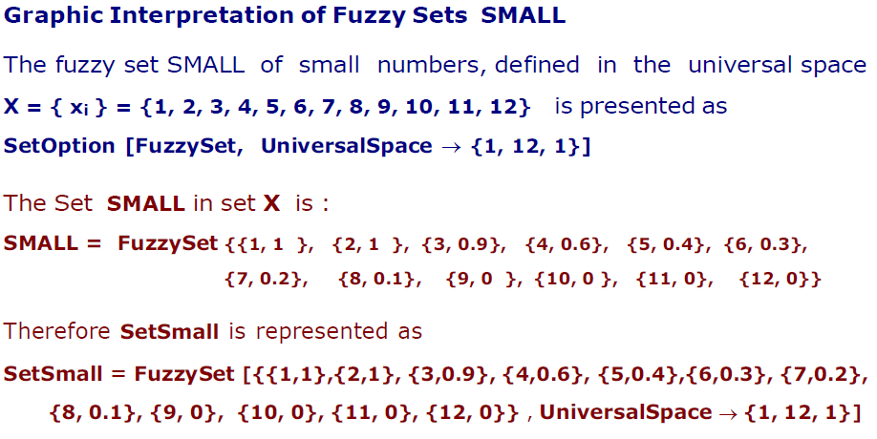

Slide 3
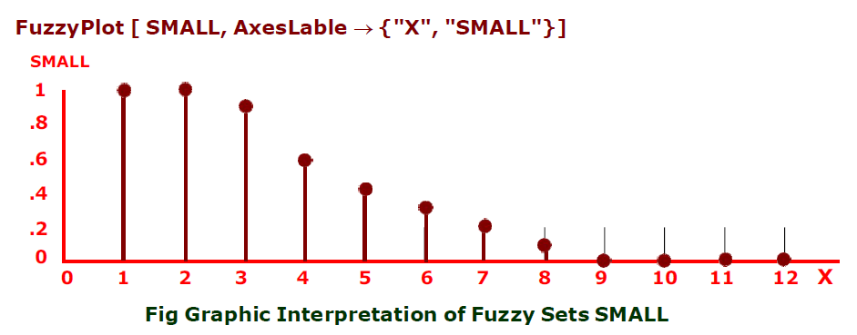

Slide 4
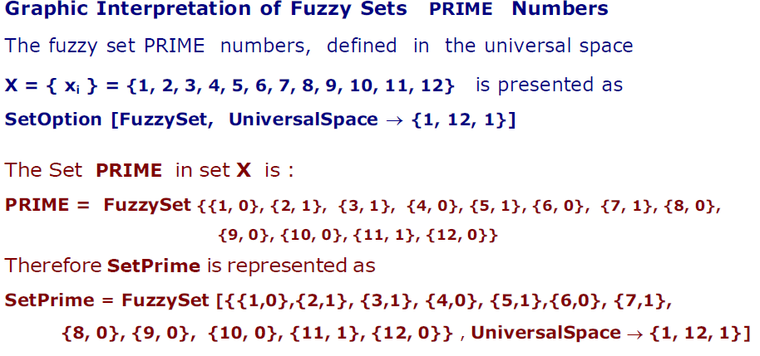

Slide 5
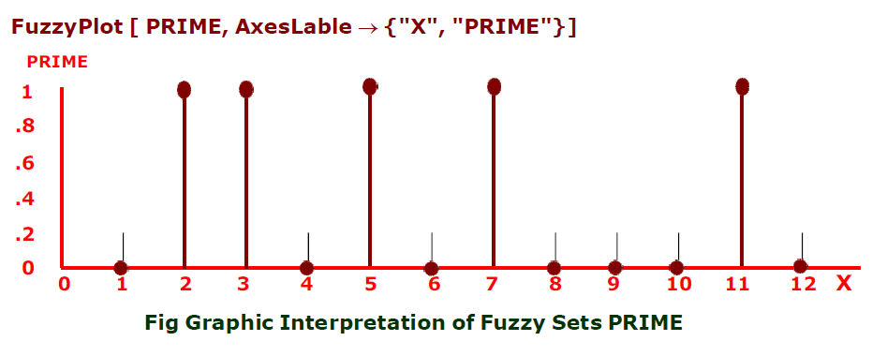

Slide 6
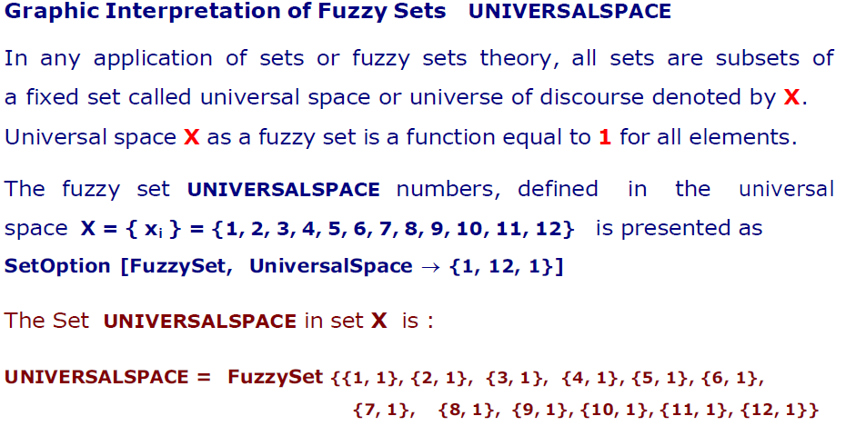

Slide 7
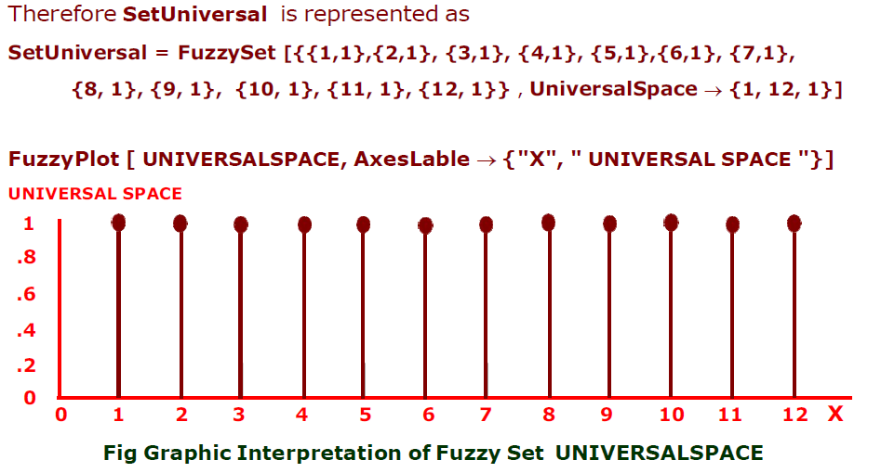

Slide 8
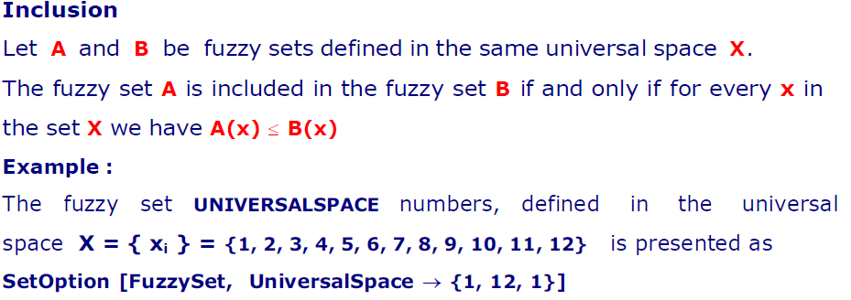

Slide 9
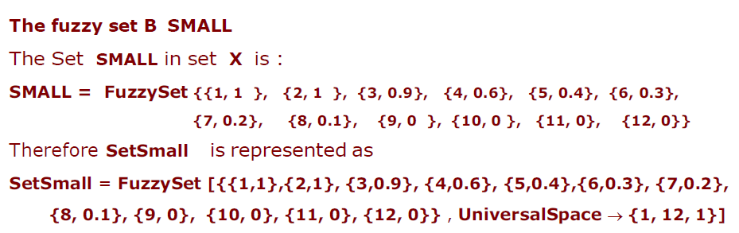

Slide 10
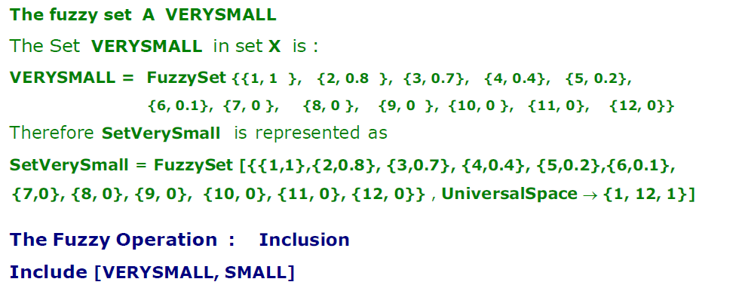

Slide 11
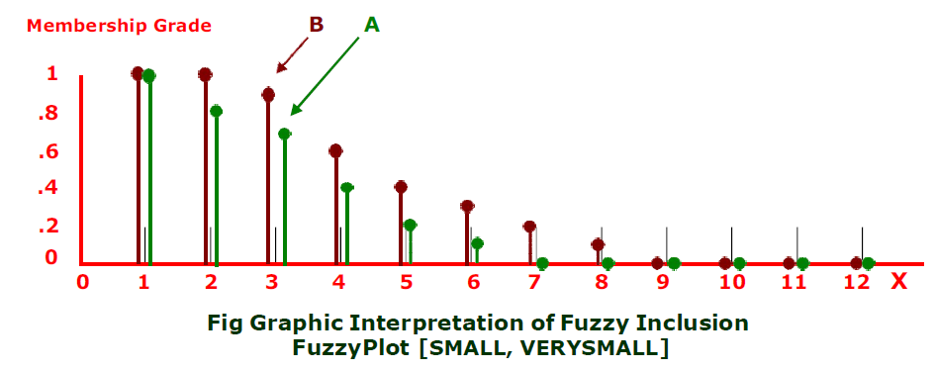

Slide 12
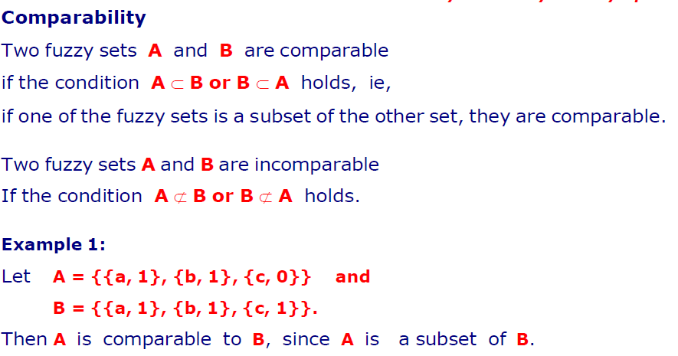

Slide 13
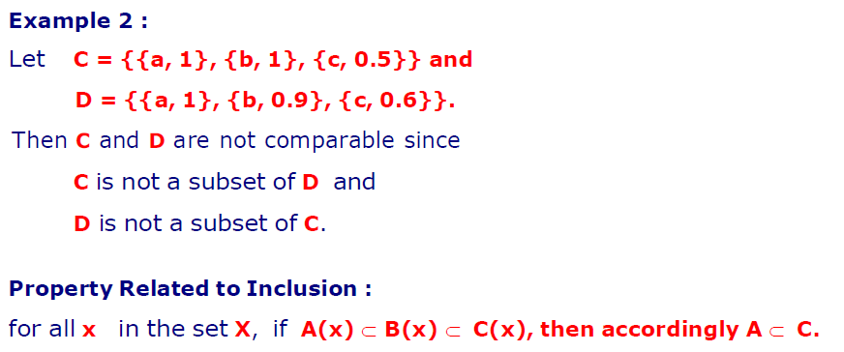

Slide 14
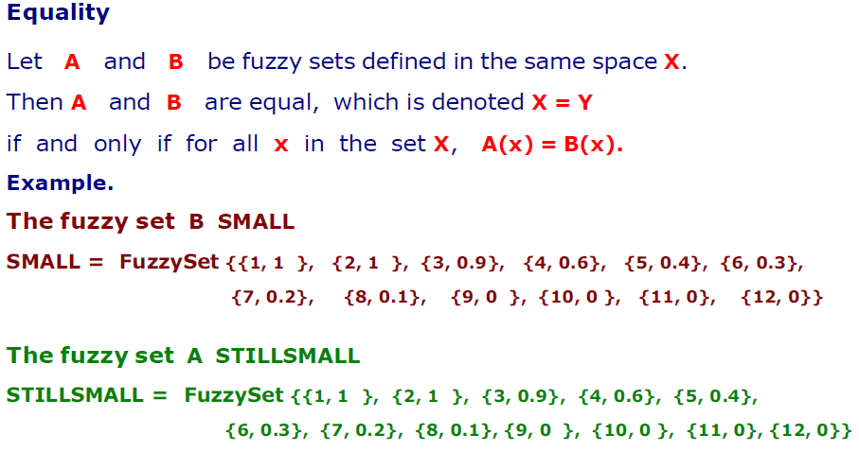

Slide 15
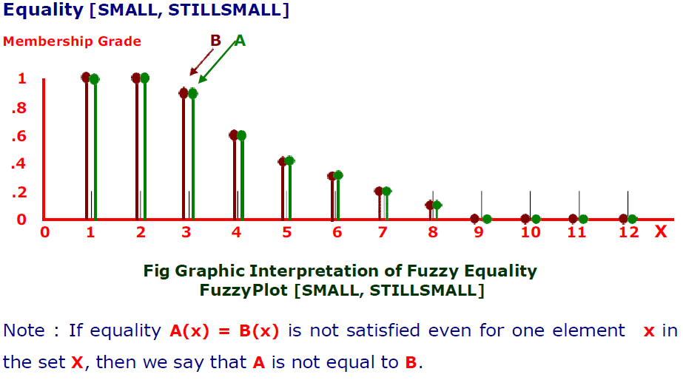

Slide 16
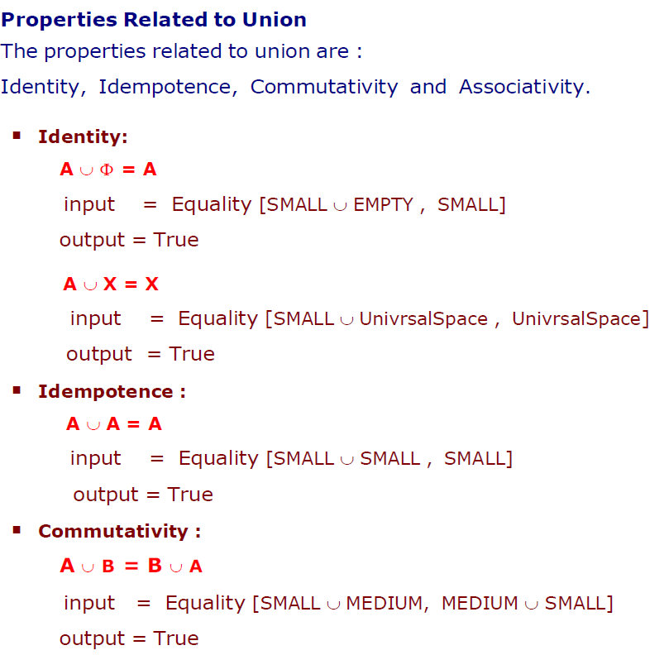

Slide 17
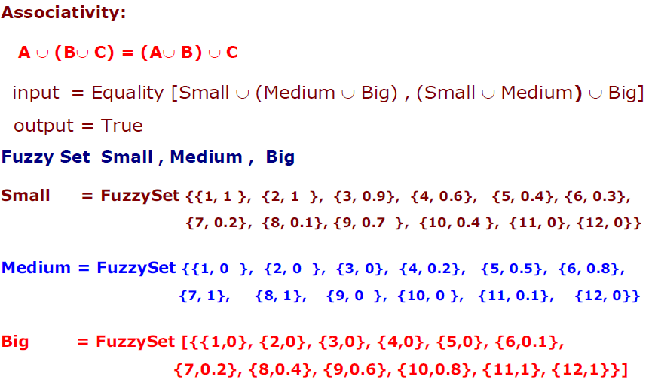

Slide 18
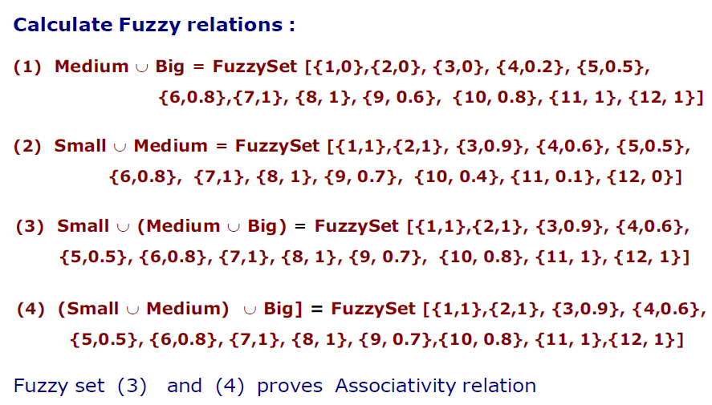

Slide 19
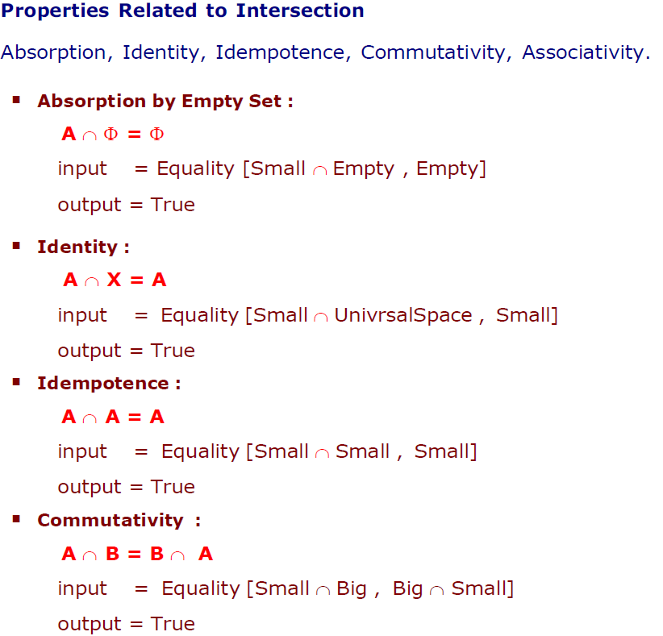

Slide 20
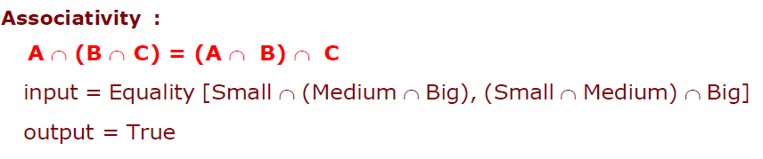
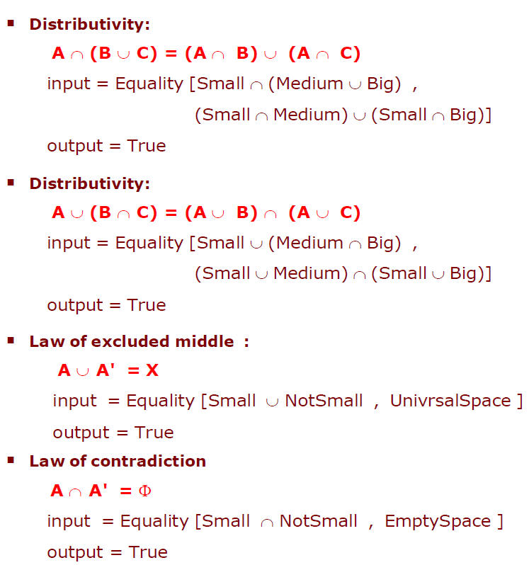

Slide 21
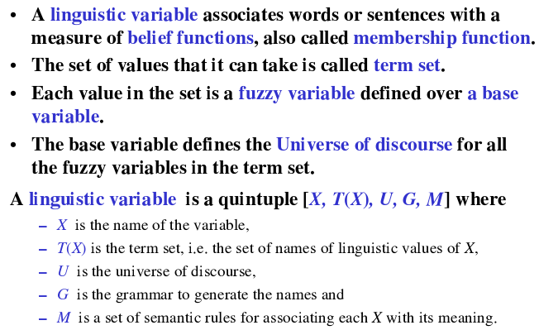
LINGUISTIC VARIABLE

Slide 22
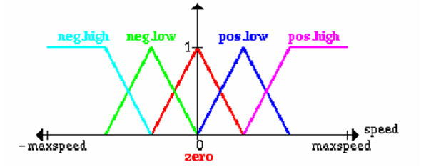
LINGUISTIC VARIABLE
Let x be a linguistic variable with the label “speed”.
Terms of x, which are fuzzy sets, could be “positive low”, “negative high” from the term set T:
T = {PostiveHigh, PositiveLow, NegativeLow, NegativeHigh, Zero}
Each term is a fuzzy variable defined on the base variable which might be the scale of all relevant velocities.

Slide 23
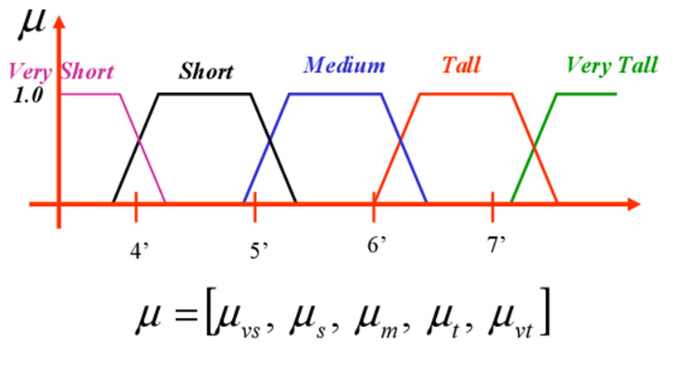
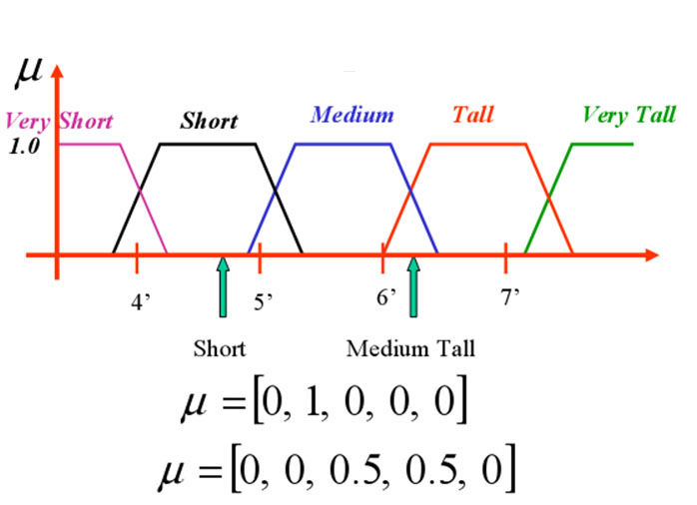
MEMBERSHIP FUCNTIONS

Slide 24

12/12/14
CSE510, Lovely Professional University, Phagwara

